Slide 1
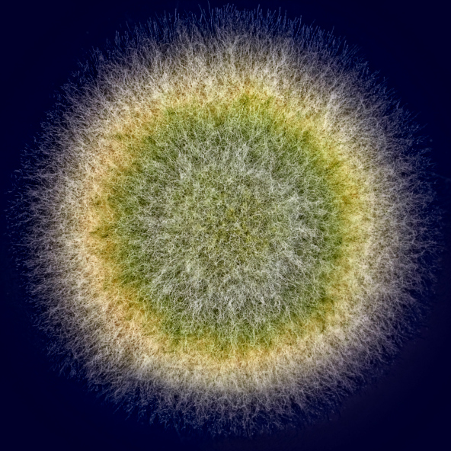

Mold in the Workplace
Investigation
Wisdom Consultants

Slide 2
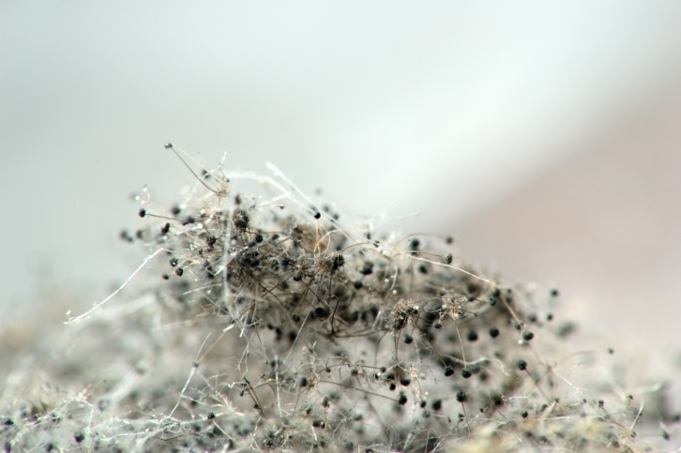
What is mold?
Mold – microorganism – grows by hyphae
Propagates – by spores, either asexual or sexual

Slide 3
Molds are ubiquitous!
Molds are everywhere….we can’t see
Can grow indoors
Produce
Fragments of mycelium
Spores
Chemicals (byproducts of metabolism)
Antibiotics
VOCs
Mycotoxins (toxigenic molds)

Slide 4
What triggers mold investigation?
Complaints of illness - Occupants inhale mold byproducts
Odours
Water intrusion
Presence of visible mold
No enforceable legal standards

Slide 5
Assessing Health Effects from Mold Controversial
Individual immune systems differ
- very young / old / immuno-compromised (cancer therapy, AIDs)….more susceptible
No. of immuno-compromised people in society increasing….living functional lives (outside hospitals)
Cannot assume “all occupants healthy”
Mold hard to study in humans
- dose-response relationships not established in humans

Slide 6
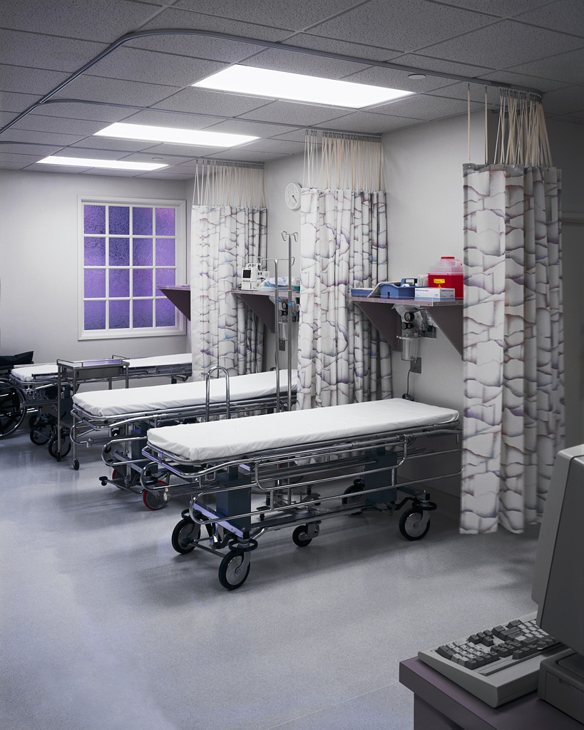
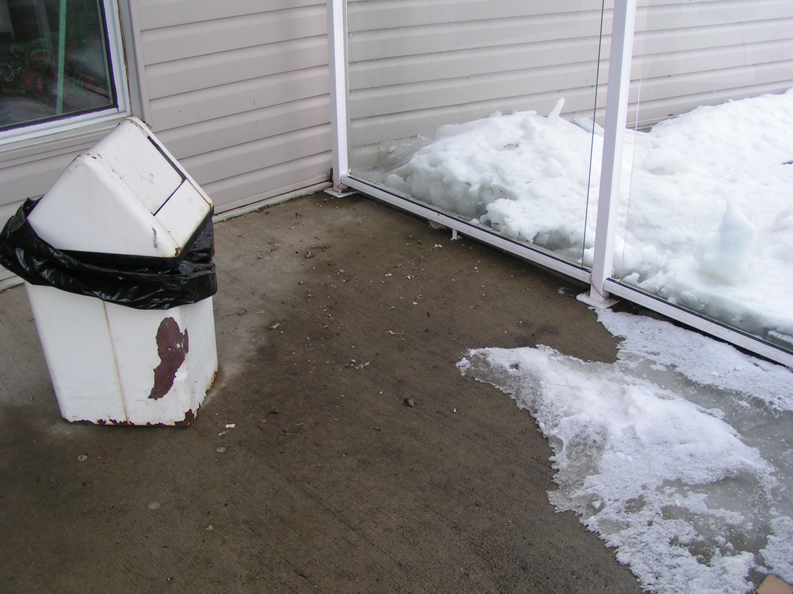
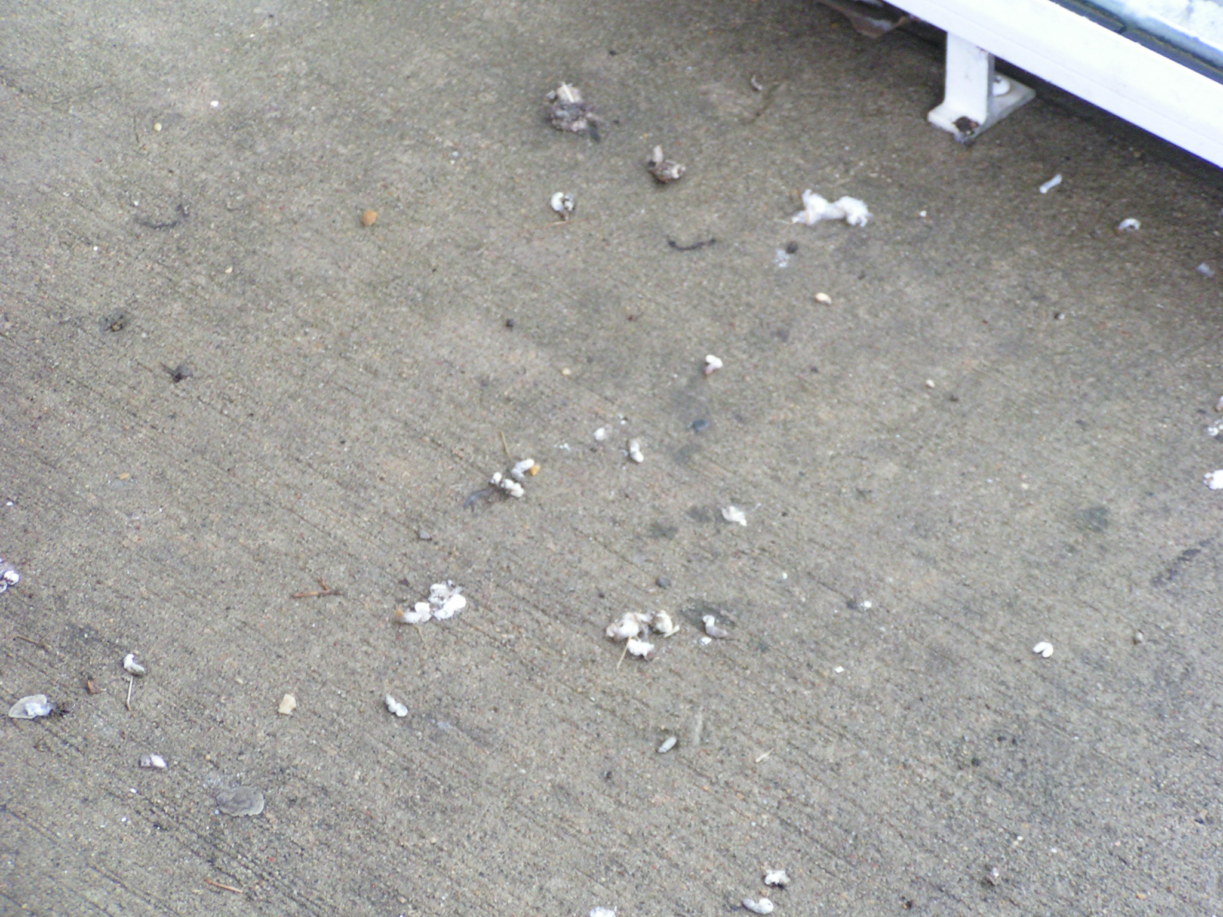
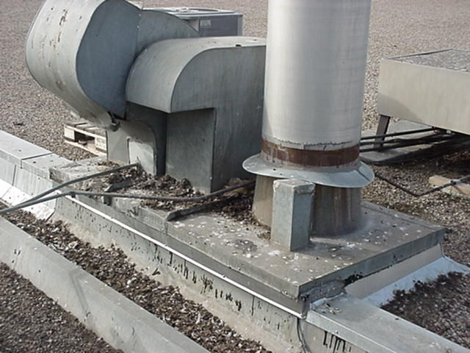
Specific Health Effects linked to Certain Molds
Infections
- Aspergillus fumigatus (hospital acquired)
most common fungal infection in world…invasive to lungs
- Cryptococcus neoformans & Histoplasma capsulatum
In bat / bird droppings (pneumonia)

Slide 7
Specific Health Effects linked to certain molds
Allergic Reaction / Irritation
Aspergillus fumigatus, Alternaria, Penicillium, Fusarium genera…linked to allergic reaction.
- Aspergillus, Penicillium indoors
Toxicosis
Body’s reaction to mycotoxins. Stachybotrys
Earliest reports (Siberia)…large no. of horses died from moldy hay….hemorrhage of GI tract, lung inflammation, blood clotting effects.

Slide 8
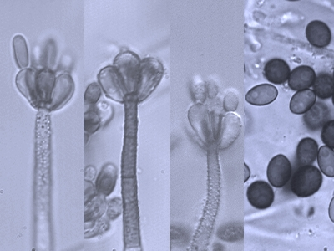
Specific Health Effects linked to certain molds
Stachybotrys atra (black mold)…trichothecenes, blood
Aspergillus flavus…aflatoxin B1, liver carcinogen
Aspergillus versicolor…sterigmatocystin, affects liver
EM Lab P&K

Slide 9
Mold Investigation - 10 Steps
Act Immediately – water intrusion…Restoration company
Find Qualified Help
Meetings - Owners, managers, maintenance
Site Investigation – water damage, hidden moisture, mold
Confidential Interviews – signs & symptoms
Sampling
Surface or bulk
Air Sampling – Spore trap, Culture

Slide 10
Mold Investigation - 10 Steps
Written Report
Removal of Staff or Occupants
Remediation of Building or Site
Communication – to management, encourage communication to occupants

Slide 11
Air Sampling for Mold
Two main types
Spore trap analysis (2 days)
Air through sticky cassette – spores stick
Direct microscopic exam of spores
Spores / m3
Culture (5 to 7 days)
Grow mold on agar in petrie dish
Growth characteristics + reproductive structures
CFUs / m3

Slide 12
Air Sampling for Mold
Perform both types of sampling – same time
Spore traps difficult to interpret
Sticky material on cassettes not consistent
Spore Trap method cannot identify fungi to genus level
Cannot distinguish Aspergillus from Penicillium spores
Spores too small
Compare results – increased certainty
two methods should agree
Culture Method – identifies to genus level
Can distinguish Aspergillus vs. Penicillium
Understand potential health effects

Slide 13
Interpretation
Looking for patterns, know different genera
Genera – grow indoors vs. outdoors
Genera – grow on damp building materials
Genera – not routinely airborne
Genera – special media
Genera – produce mycotoxins
Genera – that can be pathogenic

Slide 14
Interpretation
Cladosporium – leaf fungi, mainly outdoors
Grow on damp building materials – Aspergillus, Penicillium, Acremonium, Stachybotrys
Not routinely airborne – Stachybotrys
Special media – Stachybotrys
Mycotoxins – Aspergillus, Penicillium, Stachybotrys
Pathogenic - Aspergillus

Slide 15
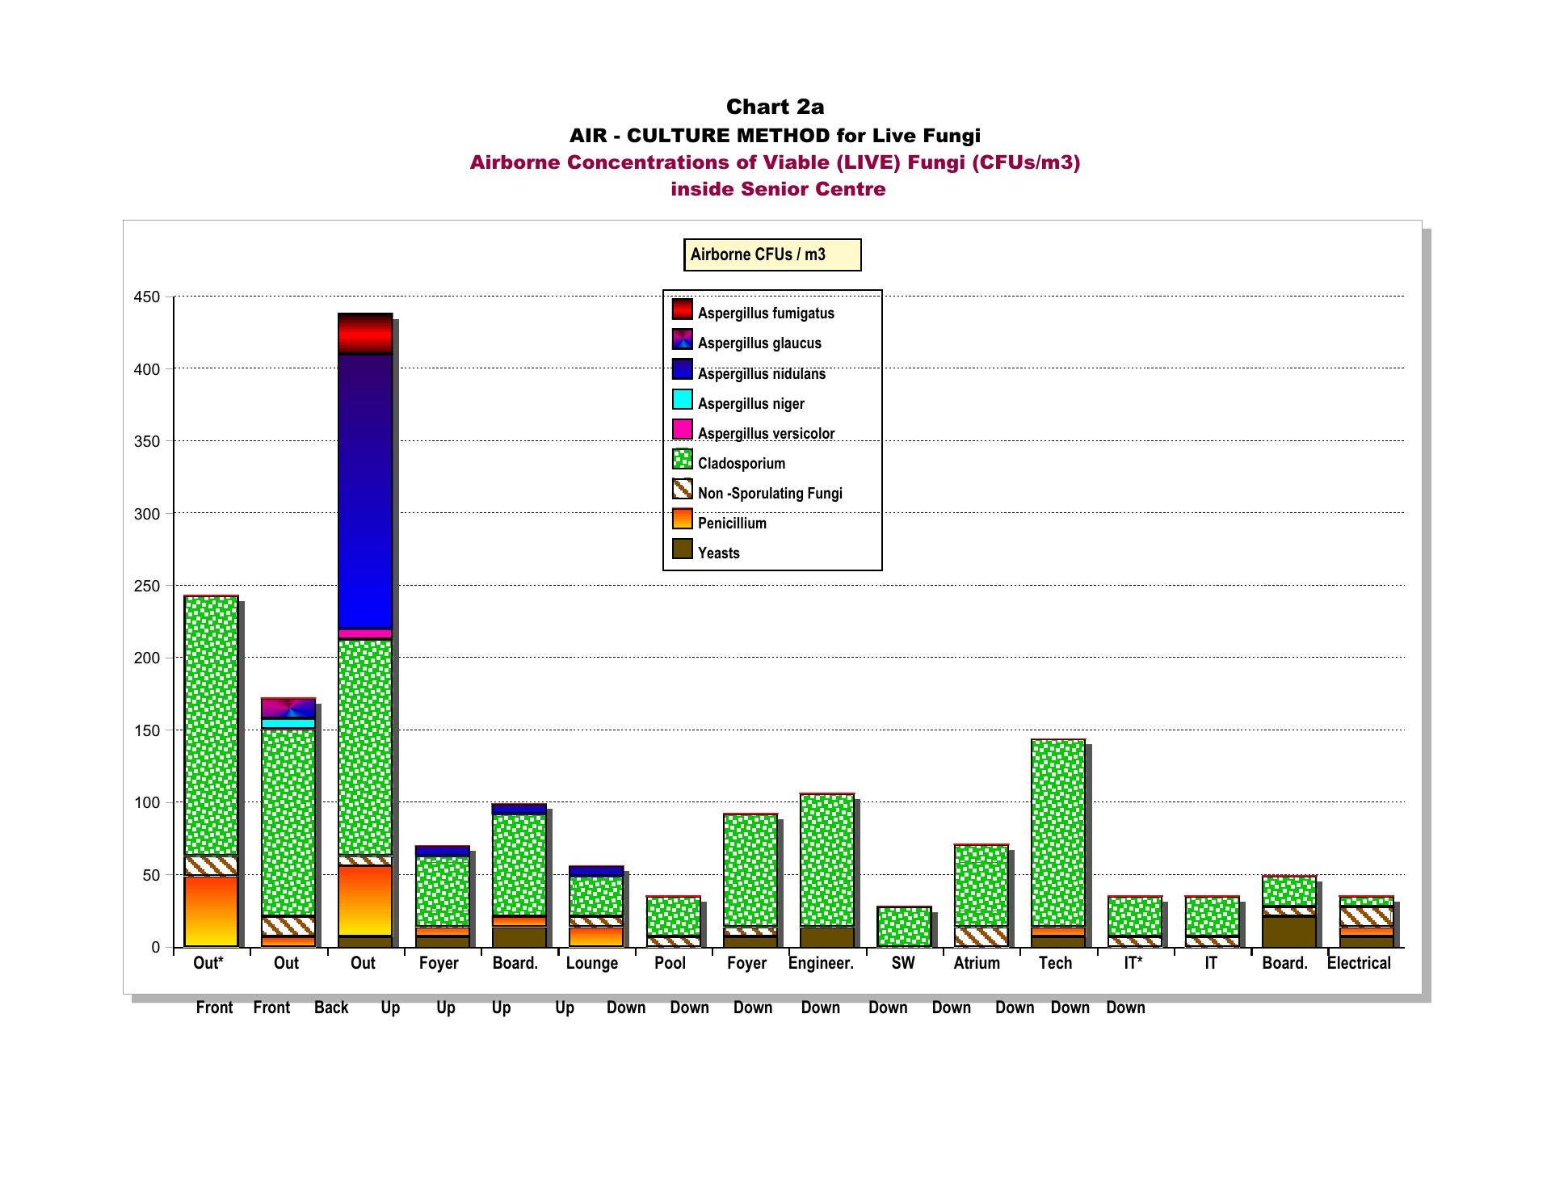
Live Airborne Mold – CFUs/m3

Slide 16
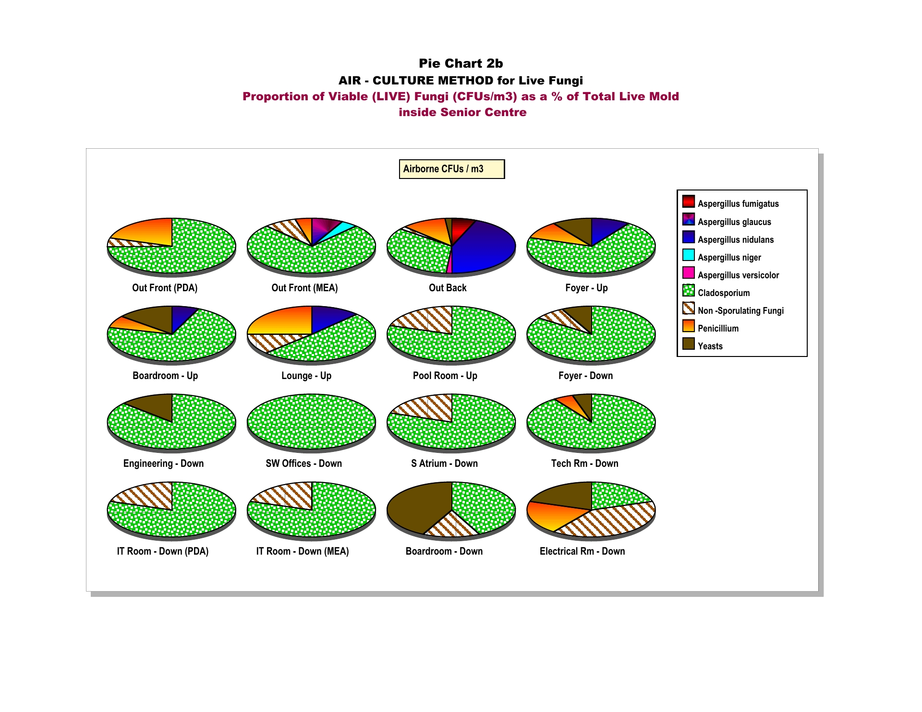
Airborne Live Mold - Proportions

Slide 17
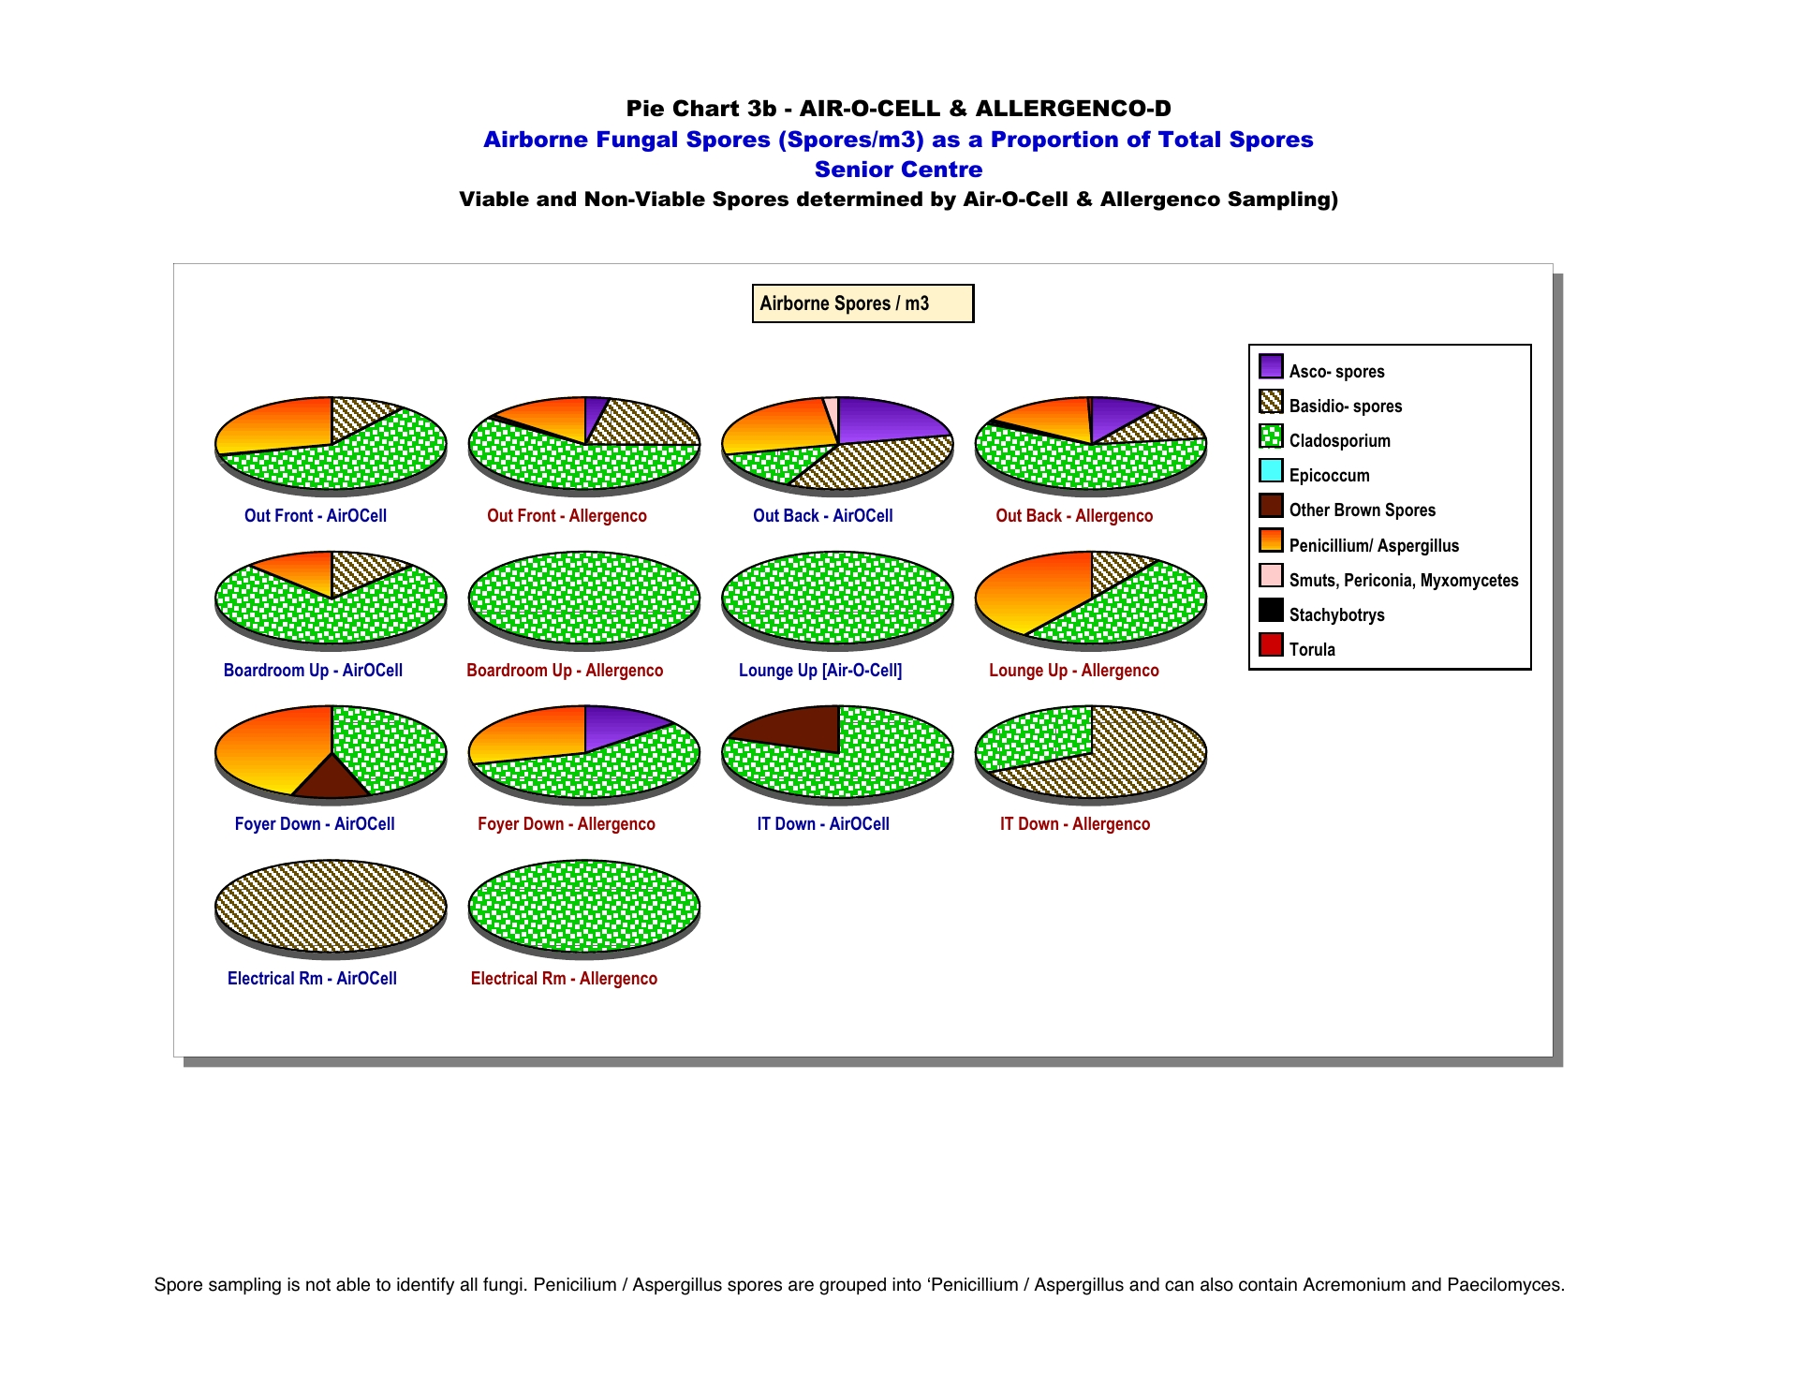
Airborne Mold Spores – Spore Proportions

Slide 18
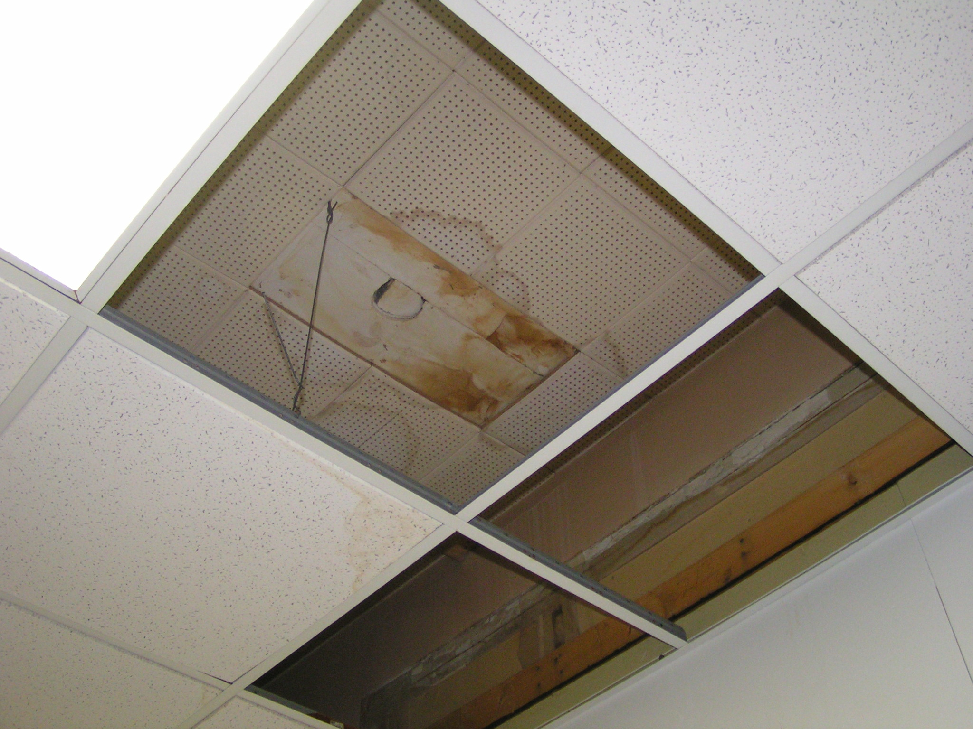
Water Damage

Slide 19
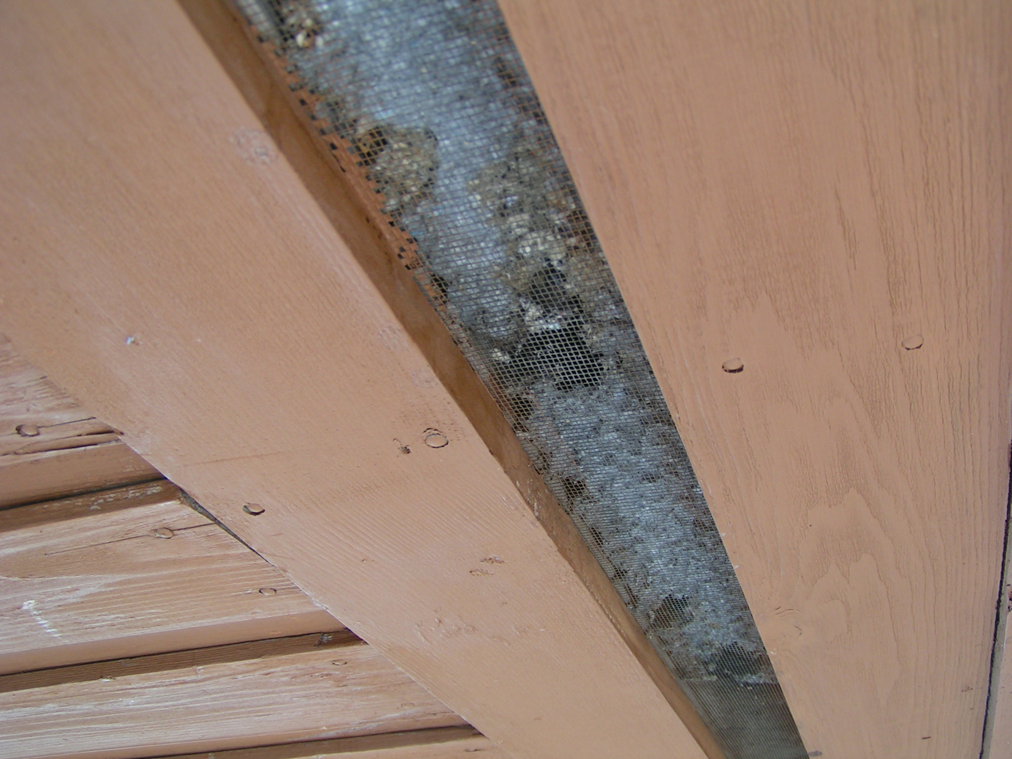
Entrance to Building

Slide 20
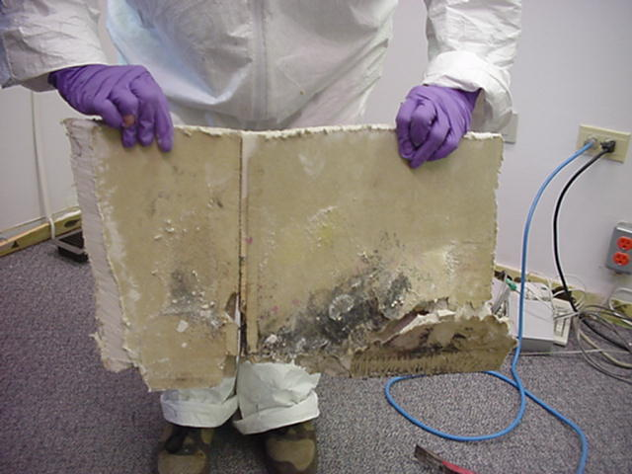
Mold Growing Behind Wall

Slide 21
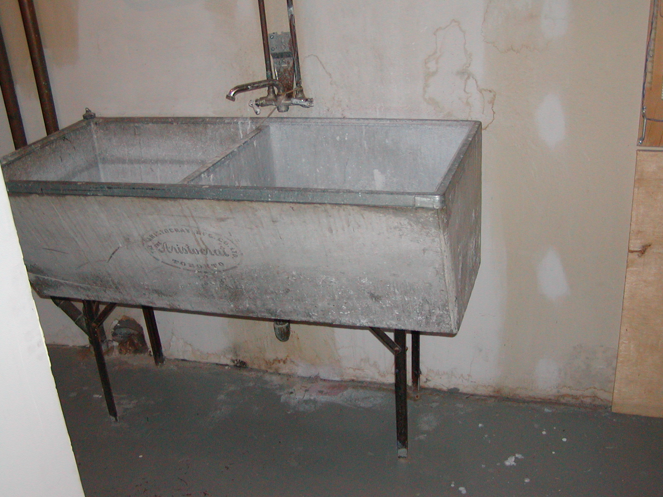
Mold Growing Behind Wall

Slide 22
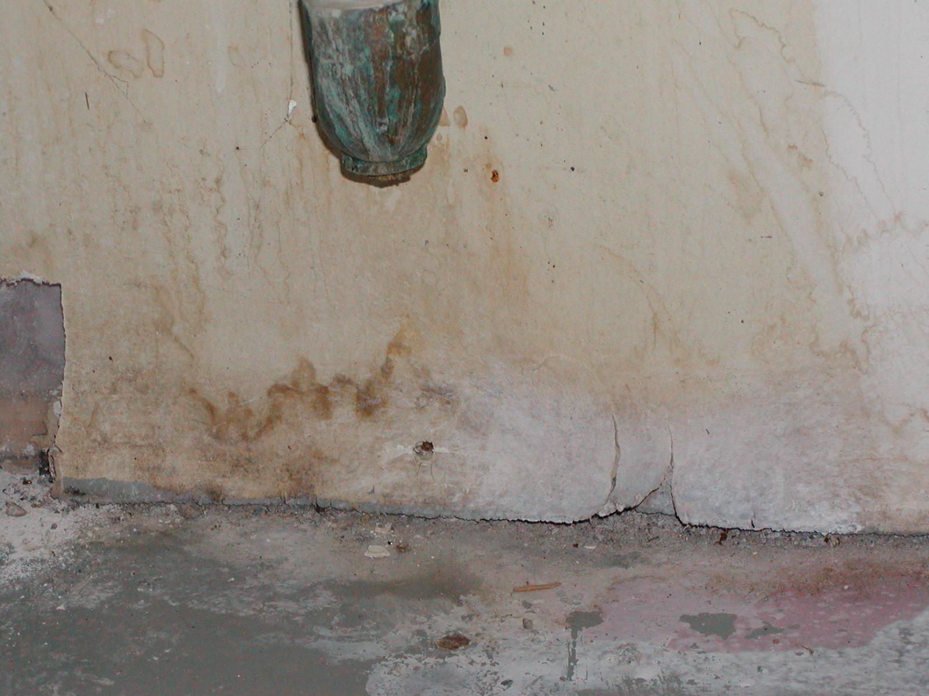
Mold Growing Behind Wall

Slide 23
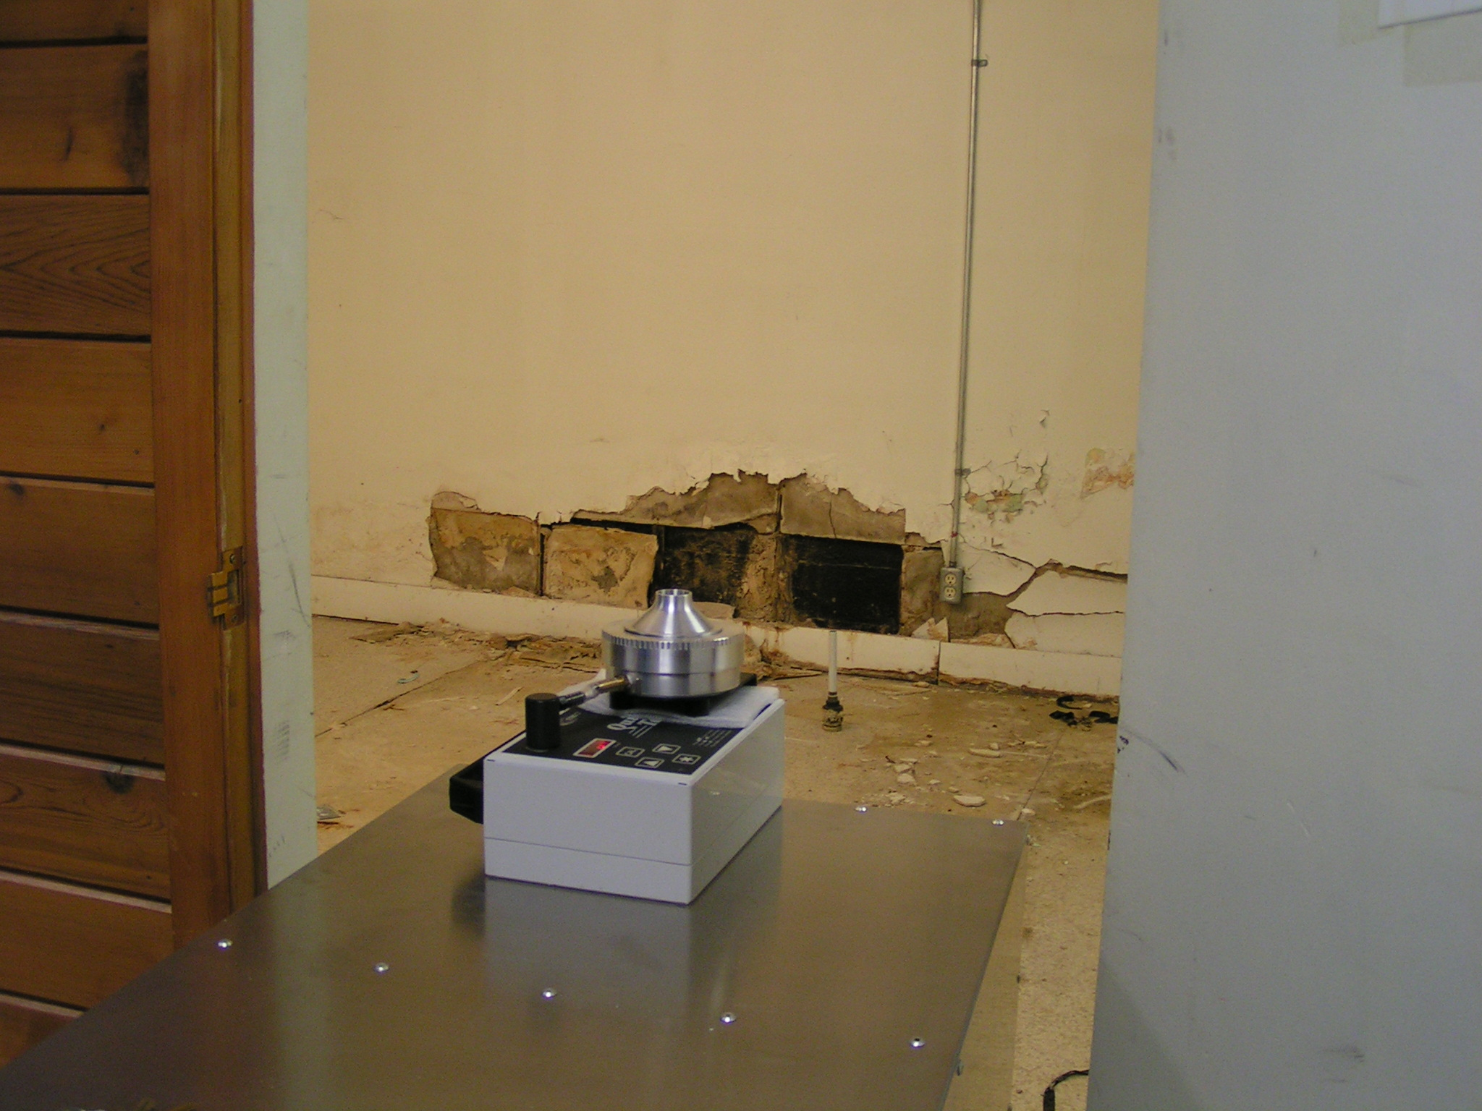
Mold Air Sampling

Slide 24
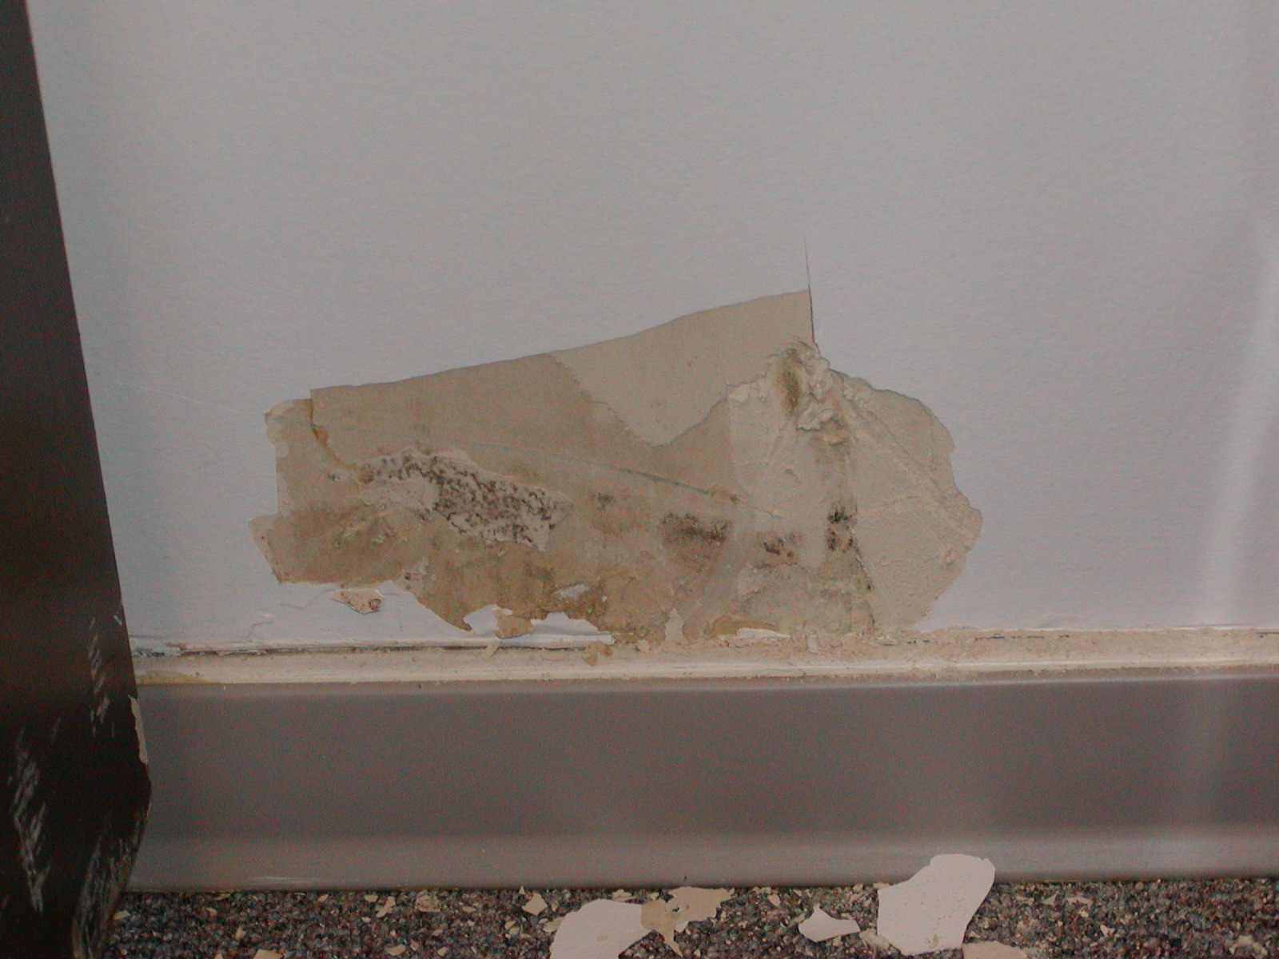
Mold Growing Behind Paint Layer

Slide 25
Reference Material
Moldconsultants.ca
Wisdommoldconsultants.com
3rd Page of Website
Wisdomconsultants.com
Wisdomconsultants.ca

